Slide 1
Abstract Classes & Interfaces

Slide 2

Objectives
At the end of this lesson, you will be able to :
Describe what are abstract classes
Discuss what are abstract methods
Implement abstract classes
Describe what are interfaces
Use interfaces
Notes:
Welcome to the lecture. In this lecture you will learn about abstract classes and interfaces. At the end of this lecture, you will be able to describe what are abstract classes, discuss what are abstract methods and implement abstract classes. Last but not least, you will be able to describe what are interfaces and use interfaces in C#.

Slide 3
Before learning Abstract classes
Shape
-type:string -color:string
+Shape() +Shape(string,string) +FindArea():double +ToString():string
to be overridden
Circle
-radius:double
+Circle() +Circle(string,double) +FindArea():double +ToString():string
Square
-length:double
+Square() +Square(string,double) +FindArea():double +ToString():string
Notes:
Let us look at one example before we learn abstract classes.
We have a Shape class that simulate all types of shapes. It has 2 attributes, type to record the type of the shape (e.g. Circle) and color (e.g. yellow), of course to record the color of the shape.
Shape class has 2 subclasses, Circle and Square. Circle has an attribute radius while Square has an attribute length. We’d like to find the area for any objects of these classes thus we defined the FindArea() method in both classes.

Slide 4
Example - Shape class
Before learning abstract classes, we need to implement FindArea() method with some 'dummy' implementation
To enable Shape variable that points to the object of the subclass to use the method
e.g.
class Shape
{
. . .
. . .
public virtual double FindArea()
{
return 1.0; // ‘dummy’ implementation (not meaningful)
}
}
Notes:
Recall in the class diagram in the previous slide, we defined the FindArea() method in the super class, Shape . This is needed so that variable of Shape type that either points to Circle object or Square object can call the FindArea() method. However, as Shape is just a generic geometric shape, we do not have a formula to use to find the area. Hence an arbitrary value, say, 1, is returned from the method, as shown in the example here.

Slide 5
Shape class – Full implementation
class Shape
{
public string Type { … } // Property
public string Color{ … } // Property
. . .
public virtual double FindArea()
{
return 1.0; // dummy
}
. . .
Implementation
not meaningful
class Circle : Shape
{
public double Radius { … } // Property
. . .
public override double FindArea()
{
return Math.PI * Radius * Radius;
}
. . .
class Square : Shape
{
public double Length { … } // Property
. . .
public override double FindArea()
{
return Length * Length;
}
. . .
Notes:
This slide shows the full implementation for the 3 classes omitting the constructors and accessor methods in the properties.
The implementation of FindArea() method in Shape class is not meaningful as it returns an arbitrary value. You may ask why 1, how about 0, or what about nothing? Well, you have to return a numeric value as the method has a return type of double.
Then how about we don’t define this method at all? Well, if FindArea() is not defined in Shape, you can’t call FindArea() if your Circle object is being referenced by variable of type Shape.
To prevent the situation of defining a method with an implementation that is not meaningful in a class that do not have any objects of its own, we define the method as abstract method and the class as abstract class. More detail about abstract classes coming up next.

Slide 6
Abstract Classes
&
Abstract Methods

Slide 7
Representing Abstract Classes in UML
Class name in italic
Shape
-type:string -color:string
+Shape() +Shape(string,string) +FindArea():double +ToString():string
abstract method in italic
Circle
-radius:double
+Circle() +Circle(string,double) +FindArea():double +ToString():string
Square
-length:double
+Square() +Square(string,double) +FindArea():double +ToString():string
Notes:
Given the class diagram, how does one know that the class is to be implemented as abstract class and the method is to be implemented as abstract method?
Well, for an abstract class, type the class name in italic font style; likewise, for an abstract method, use italic font style to indicate that it is abstract method.
As shown in the class diagram on the slide, we know that Shape class is to be implemented as abstract class and FindArea() method is to be implemented as abstract method.

Slide 8
Shape class (as an abstract class)
abstract class Shape
{
public string Type { … } //Property
public string Color{ … } //Property
. . .
public abstract double FindArea();
. . .
Abstract Method
(with no ‘body’)
needs to be
implemented in
the subclasses
class Circle : Shape
{
public double Radius { … }
. . .
public override double FindArea()
{
return Math.PI * Radius * Radius;
}
. . .
class Square : Shape
{
public double Length { … }
. . .
public override double FindArea()
{
return Length * Length;
}
. . .
Notes:
Add the keyword “abstract” in front of the class header to indicate that the class is an abstract class.
Add the keyword “abstract” in front of the return type to indicate that the method is an abstract method. Furthermore, remove the method body but just terminate with a semicolon.

Slide 9
What are Abstract Classes ?
An abstract class is a Class that :
is NOT fully implemented, CANNOT be instantiated
cannot use the ‘new’ keyword to create objects from an abstract class
may contain abstract method(s)
methods containing only the method signature, without the body (i.e. no implementation)
is to be inherited (derived) by subclasses to provide implementations for the abstract methods
is defined using the keyword abstract
Notes:
As you have seen in the example in the last slide, an abstract class is not fully implemented, no object can be created. It may contain one or more abstract methods, which is a method that is declared, but contains no implementation.
Abstract classes must be inherited by subclasses to provide implementations for the abstract methods.
To define the class as abstract class, the keyword “abstract” is to be used.

Slide 10
Abstract Methods
An abstract method is a method that :
contains only the method signature
has NO method 'body' (i.e. no implementation)
needs to be implemented (overridden) in the subclasses
is defined using the keyword abstract
Notes:
An abstract method is a method that has only the method signature without any method 'body’. It must be overridden in the subclasses.
An abstract method is defined using the keyword abstract.

Slide 11
Format of Abstract Class & Abstract Method
abstract class ClassName
{
// attributes (data)
. . .
// behaviors (methods)
. . .
// abstract method(s)
public abstract retType MethodName (parameter_list); // no ‘body’
. . .
}
* An abstract method can exist only in an Abstract Class
* An abstract class may contain both concrete and abstract methods
Notes:
This slide shows the format of abstract class and abstract method.
An abstract class can still have properties and other methods just like what you have learnt in the last few weeks. On top of these, it may contain one or more abstract methods.
If a class contains an abstract method, this class must be an abstract class.

Slide 12
Example - Abstract Class
abstract class Shape {
// properties
public string Type { get; set; }
public string Color { get; set; }
// behaviors (constructors and methods)
. . .
// abstract method(s)
public abstract double FindArea(); // no ‘body’
}
Notes:
This slide shows an example of Shape class that is defined as abstract class with an abstract method FindArea()

Slide 13
Shape class (as an abstract Class)
The FindArea() method is defined as abstract method
allows variable of either Circle or Square object to use the method,
method only has the method signature and no method body
Shape class must be defined as abstract class
abstract class Shape
{
. . .
. . .
public abstract double FindArea(); // no ‘body’
}
The implementation of FindArea() need to be provided in all the subclasses
Notes:
In the shape class that is defined as an abstract class, the FindArea() method is defined as an abstract method. This ensures that all the non-abstract subclasses override the method. That is, Circle class has its own FindArea(), Square class also has its own. In the future if we add in a few more subclasses, each of these subclasses will have their own FindArea() methods too.

Slide 14
Note
A class that is fully implemented (e.g. Circle, Square) is known as a concrete class and hence can be instantiated
e.g.
Circle c = new Circle("Red", 5.0); // ok
An abstract class is a class that is NOT fully implemented and hence cannot be instantiated
e.g.
Shape s = new Shape("Shape", "Red"); // not allowed
Shape s = new Circle("Red", 5.0); // ok
Notes:
There are two types of classes, concrete and abstract. A class that is not abstract is known as concrete class. The classes that we have been writing before this lesson are all concrete classes.
All concrete classes can be instantiated, that is, object of the class can be created.
However, abstract class cannot be instantiated. Hence, new Shape() will cause a syntax error even if you pass in correct arguments.

Slide 15
Using Abstract Classes
To use an abstract class, you need to
inherit it in the subclasses using : BaseClass
implement the abstract method(s) in the subclasses
Notes:
Some of you may be wondering, how to use an abstract class if I cannot create objects from it.
Well, you can inherit it!
E.g. you want to define 2 classes that have a lot of common attributes and behaviors. To prevent duplication, you put all the common attributes and behaviors in a superclass and write these 2 classes as subclasses to inherit from the superclass. As you do not want to create any object from this superclass, we define this superclass as abstract class.
Take NPal as an example. The system keeps track of both staff and student records. Staff and students are both type of Person, they have a lot of common attributes and behaviors. Hence the system could have a Person class as an abstract class that is inherited by two subclasses, Staff and Student.

Slide 16
Demo
ShapeApp
Notes:
The next few slides provide a demo of the ShapeApp.

Slide 17
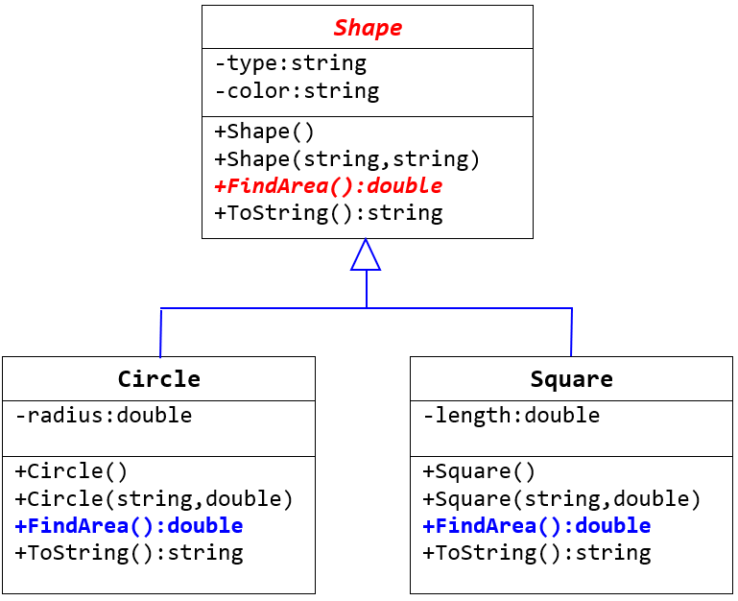
Shape.cs (abstract class)
abstract class Shape
{
public string Type { get; set; }
public string Color { get; set; }
public Shape() { }
public Shape(string t, string c) {
Type = t;
Color = c;
}
. . .
public abstract double FindArea();
public override string ToString() {
return “Type: “ + Type +
“\tColor: “ + Color;
}
}
Notes:
The implementation of the Shape class is given here. Take note that it is defined as an abstract class with an abstract method FindArea().

Slide 18
Subclass 1 – Circle.cs
class Circle : Shape // inherit abstract class
{
public double Radius { get; set; }
public Circle() : base() {
radius = 1.0;
}
public Circle(string c, double r) : base("Circle", c) {
radius = r;
}
// override the abstract method
public override double FindArea()
{
return Math.PI * Radius * Radius;
}
public override string ToString() {
return base.ToString() + “Radius: “ + Radius;
}
}
Notes:
The implementation of the Circle class is given here. Circle class is defined as subclass of Shape class. It has to override the FindArea() method.
Note that in the constructor, it invokes the superclass constructor passing in the string literal “Circle” as the value for type and the variable c as the value for color.

Slide 19
Subclass 2 – Square.cs
class Square : Shape // inherit abstract class
{
public double Length { get; set; }
public Square() : base() {
length = 1.0;
}
public Square(string c, double len) : base("Square", c)
{
Length = len;
}
// override the abstract method
public override double FindArea()
{
return Length * Length;
}
public override string ToString() {
return base.ToString() + “Length: “ + length;
}
}
Notes:
The implementation of the Square class is given here. Same as Circle class, Square class is also defined as subclass of Shape class hence it has to override the FindArea() method.
Note that in the constructor, it invokes the superclass constructor passing in the string literal “Square” as the value for type and the variable c as the value for color.

Slide 20
Program.cs
static void Main(string [ ] args)
{
List<Shape> shapeList = new List<Shape>();
Shape s1 = new Circle("Red", 10.0);
Shape s2 = new Square("Blue", 10.0);
Shape s3 = new Square("Black",20.0);
shapeList.Add(s1);
shapeList.Add(s2);
shapeList.Add(s3);
foreach (Shape s in shapeList)
{
Console.WriteLine(s.ToString() +
“/tArea: “ + s.FindArea());
}
}
Notes:
This is a simple Program class that creates 1 Circle object and 2 Square objects. The objects are added into the List called shapeList. It then uses a loop to iterate over each element in the List, display the detail of each object together with the area.

Slide 21
Quiz
Notes:
Quiz time!

Slide 22
Quiz – Any errors in the following code?
Question 1
abstract class AbstractClass1
{
public abstract void AbstractMethod();
public string ToString()
{
return “this is an abstract class”;
}
}
Question 3
abstract class AbstractClass3
{
public void AnyMethod()
{
// do something
}
}
Question 4
abstract class AbstractClass4
{
public abstract void AbstractMethod();
}
static void Main(string[] args)
{
AbstractClass4 obj = new AbstractClass4();
}
Question 2
class AbstractClass2
{
public abstract void AbstractMethod();
}
Notes:
Study the code in these 4 questions. Are you able to identify which question has error?

Slide 23
Interfaces

Slide 24
Interfaces
An interface
contains definitions for a group of related functionalities that a concrete class must implement
is a template that specifies what must be in a class that implements the interface
cannot be instantiated
is defined by using the keyword interface
by using interfaces, you can include behavior from multiple sources in a class
Notes:
An interface contains definitions for a group of related functionalities that a concrete class must implement. It is a template that specifies what must be in a class that implements the interface. It is somewhat like an abstract class and it cannot be instantiated. A class can implement multiple interfaces, but a class can only inherit from a single class.
An interface is defined by using the keyword interface.

Slide 25
Format of an Interface
interface InterfaceName
{
// abstract methods, without public and abstract keywords (implied)
retType MethodName1(parameter_list);
retType MethodName2(parameter_list);
retType MethodName3(parameter_list);
. . .
. . .
}
* An interface does not have data variables (but may have constants)
Notes:
This slide shows the format of an interface. All methods written in the interface are public abstract methods thus the keywords public and abstract are not required

Slide 26
Example 1 – IComparable<T> Interface
interface IComparable<T>
{
int CompareTo(T obj);
}
This interface is provided in C# for any Class whose objects need to be compared so that they can be sorted
return value of CompareTo() method is:
1 | if the current object is bigger than the other object
0 | if they are the same
-1 | if the other object is bigger
Notes:
The IComparable interface is provided in C# for any Class whose objects need to be compared so that they can be sorted.
The interface contains an abstract method CompareTo() thus it requires the implementing types to define this method, to indicate whether the position of the current object in the sort order is before, after, or the same as a second object of the same type.
The implementation of the CompareTo() method must return one of the 3 integer values as shown in the table at the bottom of the slide.
We will learn how to use it later.

Slide 27
Example 2 – IEquatable<T> Interface
interface IEquatable<T>
{
bool Equals(T obj);
}
This interface is provided in C# for any Class whose objects need to be checked if they are the same.
return value of Equals() method is:
true | if the current object and the other object is the same
false | if they are NOT the same
Notes:
The IEquatable interface is provided in C# for any Class whose objects need to be checked if they are the same.
The interface contains an abstract method Equals() thus it requires the implementing types to define this method, to indicate whether an object of the class equals to another object of the same class.
The implementation of the Equals() method must return either true or false as shown in the table at the bottom of the slide.
We will learn how to use it later.

Slide 28
Using Interfaces
To use an interface, you need to :
implement the interface using : InterfaceName
implement ALL the interface method(s) in the class
If an interface method is not used in the class, an ‘empty’ implementation is still required.
Notes:
To use an interface, first the class must implement the interface using : InterfaceName, similar to inheriting from super class.
Then all the methods in the interface must be defined in the class. Any method that do not have any code should still be defined but leave it empty.

Slide 29
Example 1
Using IComparable Interface
Notes:
The next two slides show an example of how we can make use of IComparable interface in the SalesEmployee class.

Slide 30
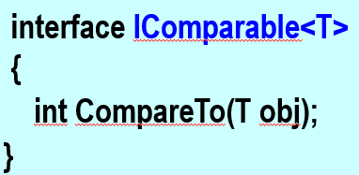
Example 1 – Using IComparable Interface
class SalesEmployee : IComparable<SalesEmployee>
{
public int Id { get; set; }
. . .
// implement the method (in the interface)
public int CompareTo(SalesEmployee e) // sort by Id
{
if (Id > e.Id)
return 1;
else if (Id == e.Id)
return 0;
else
return -1;
}
}
SalesEmployee
-id: int
-name: string
-basicSalary: int
-sales: int
+SalesEmployee(int, string, int, int)
Notes:
The header of the class shows that it implements the IComparable interface. Other than all the necessary properties and methods that you need to define in the class, we also define the CompareTo() method to compare the id of the objects.

Slide 31
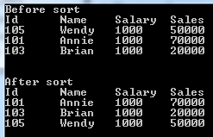
Example 1 – Using IComparable Interface
In Program.cs
List<SalesEmployee> employeeList = new List<SalesEmployee>();
SalesEmployee e1 = new SalesEmployee(105, "Wendy", 1000, 50000);
employeeList.Add(e1);
SalesEmployee e2 = new SalesEmployee(101, "Annie", 1000, 70000);
employeeList.Add(e2);
SalesEmployee e3 = new SalesEmployee(103, "Brian", 1000, 20000);
employeeList.Add(e3);
employeeList.Sort(); // sort the sales employees (objects) by Id
// print the sales employees (in sorted order by id)
foreach (SalesEmployee e in employeeList)
{
Console.WriteLine(e.Id + "\t" + e.Name +
"\t" + e.BasicSalary +
"\t" + e.Sales );
}
Sort method enable you to sort with the default comparer for the object type in the list, or specify a custom sort method.
Notes:
The program class created 3 SalesEmployee objects and add them into the list. It then calls the Sort() method which sorts the elements in the entire list using the default comparer to sort the employees by their id and display them.

Slide 32
Example 2
Using IComparable & IEquatable Interfaces
Notes:
The next three slides show an example of how we can make use of IComparable interface and IEquatable interface in the Contact class.

Slide 33
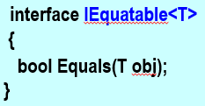
Example 2 - Using IComparable, IEquatable Interfaces
class Contact : IComparable<Contact>, IEquatable<Contact>
{
public string Name { get; set; }
public string Tel { get; set; }
// implement the methods (in the interfaces)
public int CompareTo (Contact c) // sort by Name
{
return Name.CompareTo(c.Name);
}
public bool Equals (Contact c)
{
return (Name == c.Name && Tel == c.Tel);
}
}
Notes:
The header of the class shows that it implements both the IComparable and IEquatable interfaces. Other than all the necessary properties and methods that you need to define in the class, we also define the CompareTo() method to compare the name of the objects and the Equals() method to check whether the name and tel of the two objects are equal.

Slide 34
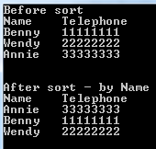
Example 2 - Using IComparable, IEquatable Interfaces
In Program.cs
List<Contact> contactList = new List<Contact>();
Contact c1 = new Contact("Benny", "11111111");
contactList.Add(c1);
Contact c2 = new Contact("Wendy", "22222222");
contactList.Add(c2);
Contact c3 = new Contact("Annie", "33333333");
contactList.Add(c3);
contactList.Sort(); // sort the contacts by name
// print the contacts (in sorted order)
foreach (Contact c in contactList)
Console.WriteLine(c.Name + "\t" + c.Tel);
Notes:
The program class created 3 Contact objects and add them into the list. It then calls the Sort() method which sorts the elements in the entire list using the default comparer to sort the contacts by their name and display them.

Slide 35
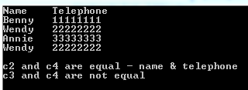
Example 2 - Using IComparable, IEquatable Interfaces
Contact c1 = new Contact("Benny", "11111111");
Contact c2 = new Contact("Wendy", "22222222");
Contact c3 = new Contact("Annie", "33333333");
Contact c4 = new Contact("Wendy", "22222222");
if (c2.Equals(c4)) // if name & telephone are same
Console.WriteLine("c2 and c4 are equal - name & telephone");
else
Console.WriteLine("c2 and c4 are not equal");
if (c3.Equals(c4))
Console.WriteLine("c3 and c4 are equal - name & telephone");
else
Console.WriteLine("c3 and c4 are not equal");
Notes:
This slide demonstrates how we can make use of the Equals() method to compare whether 2 contacts are equal.

Slide 36
Summary
Abstract classes
Abstract methods
Using Abstract classes
Interfaces
Using Interfaces
Notes:
We have come to the end of this lesson. Do post your questions in MS Teams for discussion if you have any. Thank you and good bye!

